Slide 1
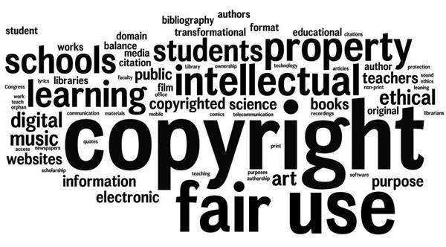

Copyright and Fair Use 2023
Image: educatorpages.com
Cynthia Horne
Circulation Librarian
*not a Copyright expert, but knows a few experts*

Slide 2
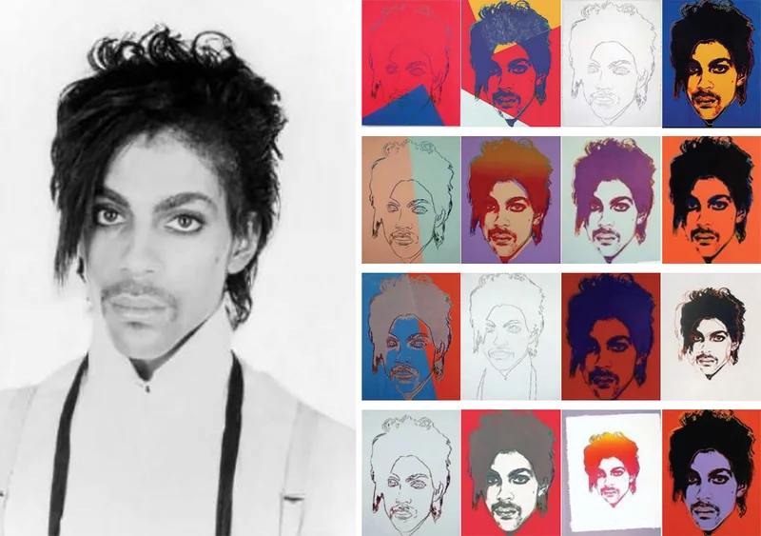
Current challenges that may impact Fair Use
Transformative Use/Derivatives
Andy Warhol Foundation v. Goldsmith
Is Warhol’s derivative painting transformative enough away from Goldsmith’s photos?
Vanity Fair paid AWF over $10k to use “Orange Prince” whereas Goldsmith received nothing.
NPR/Nina Totenberg-ATC: “The outcome could shift the law to favor more control by the original artist but doing that could also inhibit artists and other content creators who build on existing work in everything from music and posters to AI creations and documentaries.”

Slide 3



Current challenges that may impact Fair Use
Intellectual Property
Generative Artificial Intelligence and Licensing/Attribution
For more info: John Oliver Explains AI/ChatGPT
Generative AI apps are taught to ‘create’ images/code/written works based on aggregated databases of copywritten materials.
Students using ChatGPT to create written assignments.
No attributions, citation, or licensing

Slide 4

Current challenges that may impact Fair Use
The Server Test and Social Media Imbedding
The Server Test, established in the Ninth Circuit court determines that “…a website that displays an unauthorized copyrighted work can’t be held liable for infringement if the work is digitally stored elsewhere.” – Isaiah Poritz, Bloomberg News
Not nationally used for court guidance.
Creates a lot of ambiguity and gray areas
Impactful on publishing industry and social media sites

Slide 5
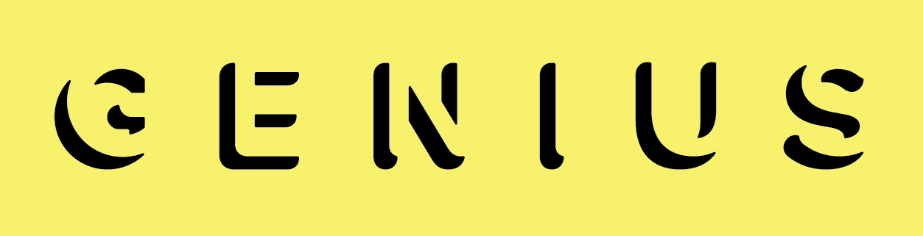

Current challenges that may impact Fair Use
Web-Scraping
The music lyric website Genius is battling Google over Google’s web-scaping of song lyrics and using them as top search results. Genius contends this diverts traffic from their site and impacts their advertising revenue. However, Genius does not own the copyright on the lyrics.
The web-scraping violates Genius’ terms of service agreements.
USSC is seeking input from the US Solicitor General on legalities.

Slide 6
Music Modernization Act
Title I—Musical Works Modernization Act
Downloads and Streaming
Title I establishes a blanket licensing system for digital music providers to make and distribute digital phonorecord deliveries (e.g., permanent downloads, limited downloads, or interactive streams).
Title II—Classics Protection and Access Act
Pre-1972 Recordings
Title II brings pre-1972 sound recordings partially into the federal copyright system and provides federal remedies for unauthorized use of sound recordings fixed before February 15, 1972.
Title III—Allocation for Music Producers Act
Producers' Royalties
Title III allows music producers, mixers, and sound engineers to receive royalties collected for uses of sound recordings by codifying a process for the designated collective (Sound Exchange) to distribute those royalties under a “letter of direction.”
Modernizes the licensing for digital music providers, gives federal protection to pre-1972 recordings, and allows producers/mixers/sound engineers to receive royalties through a codified process.

Slide 7
Copyright and academic use
Plagiarism
Copyright Infringement
The act of taking someone else’s work/ideas and passing them off as one’s own
Ethical/Academic Issue
All works
Published and unpublished, physical or electronic
Not criminal but may have penalties
Perpetual period
The use of copyrighted materials without the permission of the copyright holder
Legal Issue
Copyright protected works
Music, Art, Novels, Movies, Website content, Software, Code, etc.
Civil crime
For as long as copyright lasts
Plagiarism vs Copyright Infringement
Note: This information is plagiarized and infringes on the copyright of two creators.

Slide 8
Copyright and academic use
US Copyright
Copyright Law of the US ( United States Code Title 17)
CFR Title 37 – Patents, Trademarks, and Copyrights
https://www.ecfr.gov/current/title-37
https://www.copyright.gov/
UNC System
Section 500.2 of The Code and UNC Policy Manual
Found on the northcarolina.edu website
ECSU Patent and Copyright Procedures
Section 900.1.1 of the University Policy Manual UNC System
Found in Human Resources Forms and Documents
Copyright Policies Impacting ECSU

Slide 9
Copyright and academic use
Section 107 – Fair Use
“statutory framework for determining whether something is a fair use and identifies certain types of uses—such as criticism, comment, news reporting, teaching, scholarship, and research—as examples of activities that may qualify as fair use” https://www.copyright.gov/fair-use/more-info.html
4 Principles: Purpose/Character of use; Nature of the copyrighted work; Amount/Portion of whole used; Effect of use on market or value.
Section 108 – Library Permissions
Interlibrary Loan copies
Copies for personal research
Preservation

Slide 10
Copyright and academic use
General Rule of Thumb:
10% or one chapter of a publication.
Only available to current students.
One semester of use.
Cannot interfere with the originator’s ability to profit from the work.
Fair Use Doctrine
A limitation and exception to the exclusive right granted by copyright law to the author of a creative work. – Claudia Roggero
In US, fair use if a doctrine that permits limited use of a copyrighted material without acquiring permission from the rights holders. Example of fair use include commentary, criticism, news reporting, research, teaching, library archiving, and scholarship. It provides for the legal, unlicensed citation or incorporation of copyrighted material in another author’s work under a four-factor balancing test. – Claudia Roggero
Fair Use Doctrine/Checklists

Slide 11

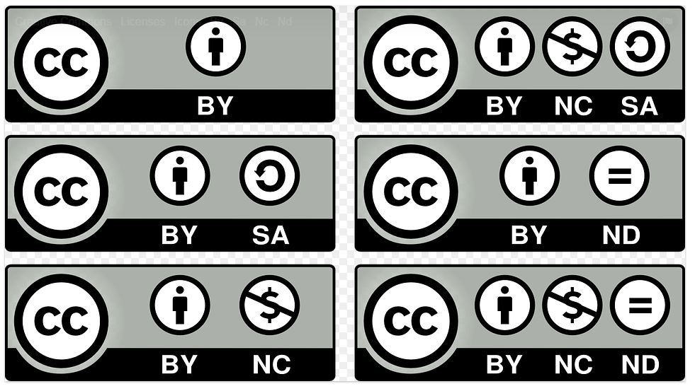
Copyright and academic use
Creative Commons Guides
BY = must cite/acknowledge source NC = only for non-commercial reuse (cannot make $$) SA = derivatives must also be freely sharable/Share Alike​ ND = no derivatives, must use the item as is.
Creative Commons/Open Access

