Slide 1


Building Up: Using Faculty Requests to build an Expansive Collection
Mary Jordan, Technical Services and Collection Development Librarian

Slide 2

Why should faculty request titles?
Faculty requests help to build a collection with wide-ranging subjects with different perspectives.
Selecting library materials supports the curriculum.
  By supporting the faculty's curriculum and needs, librarians can support and help students and their assignments.
Requesting titles helps to build communication between faculty and librarians (Hallam, Reel, & Heisserer-Miller, 2021).

Slide 3

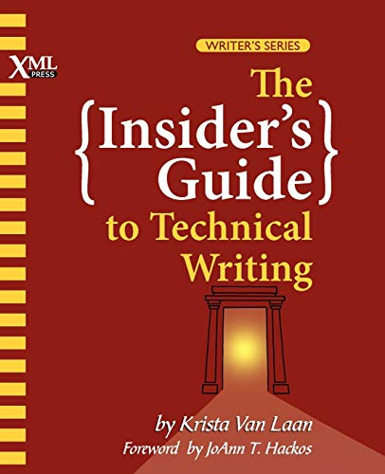




Examples of faculty-requested titles

Slide 4
Three top things to know about requesting
Each academic department (i.e., Music & Visual Arts, Business, Accounting, & Sports Management, etc.) is allotted a portion of the collection development budget each fiscal year.
Title requests need to be given by the end of February of the fiscal year.
We do not purchase textbooks unless it is foundation work for the field.
If the academic department does not spend its allotment, librarians will select materials for that department.

Slide 5
Who does what?
David Dusto
  Print and electronic serials (magazines, journals, etc.)
  Databases
  Large eBook packages
Mary Jordan
  DVDs
  Print (physical) titles
  Individual eBook titles
Nurhak Tuncer
  Music titles for the Music Library

Slide 6
How can I request titles?
Email your library liaison:
  https://www.ecsu.edu/academics/library/liaisons.html
Email me directly at mrjordan@ecsu.edu
Materials Request: http://bit.ly/3L9isUW
Please provide as much information as possible.
  ISBN, author’s name, title, etc.
  Format type: print or eBook?

Slide 7
References
Hallam, S., Reel, B., & Heisserer-Miller, R. (2021). Overdue: Collection development and deselection projects for a faculty-selected collection. College & Undergraduate Libraries, 28(1), 51–66. https://doi.org/10.1080/10691316.2021.1885548

Slide 8
National Library Week
April 24-28
Leah C. Banks, Chair
Nia Kearney, Co-Chair
Mary Jordan, Co-Chair

Slide 9
National Library Week's Events
Monday, 4/24:
  Mindful Stretch Rm 209, 6:30 pm to 7:30 pm
Tuesday, 4/25:
  Poetry Night Rm 209, 6:30 pm to 8:30 pm
Wednesday, 4/26:
  Story Time with Tiny Vikings
  Craft Night 1st floor, 6:30 pm to 7:30 pm
Thursday, 4/27:
  Black Girls Rock! Panel Discussion Ridley Student Center Rm 206, 6:30 pm to 8 pm
Friday, 4/28:
  Game Night 5:30 pm to 8 pm

Slide 10
